Slide 1

Your Applications and Modern SQL Server 2017
William Assaf

Slide 2
Your Applications and Modern SQL Server 2017
SQL Server tooling
How to get SQL Server
Isolation
Indexing, 0 to 60
Execution plans
New Features
Columnstore
Memory-optimized tables
XEvents
The Query Store

Slide 3
Workshop Logistics
Ask questions! I’ll try to answer to everyone.
Scripts and slides (for both Activate presentations) are already posted on my blog at sqltact.com so that you can follow along, click these links!
On Twitter?
#activ8conf
@activ8conf and @william_a_dba

Slide 4
How to get SQL Server - Editions
This is the link to download SQL for FREE:
Do a web search: SQL Server 2017 Downloads, click Developer
Free editions of SQL: Developer (good), Express (bad!)
Developer is same as Enterprise, but cannot be used in production
Standard edition is not free, but is roughly 20% the $ of Enterprise

Slide 5
How to get SQL Server - Tools
The tools to dev in the Microsoft ecosystem are all free, just do a web search:
SSMS (for the SQL Server)
SSDT (for SSRS, SSIS, SSAS, also for Database Projects) (installs a shell of Visual Studio)
Visual Studio Community Edition or Visual Studio Code

Slide 6
What you need
Toolbox link: in Github, or link at the top of sqltact.com
Look for toolbox.zip for an easy download, or
Click on each file then download, or
Click on each file, click “raw” on each file to copy/paste
WideWorldImporters sample database:
WideWorldImporters-Full.bak (restore to any SQL Server Edition aside from LocalDB)

Slide 7
Isolation and Performance
Concurrency: relating to how transactions treat eachother’s progress.
Transactions have different levels of isolation that affect how they regard rows in use by other transactions.
Again, text files, .csv’s, xml/json don’t have any concurrency.

Slide 8
Isolation for Data Updates
When a transaction locks records because it is writing them, other transactions become blocked.
Data that is currently being updated becomes locked for the duration of the transaction.
When the transaction completely commits or rolls back, the locks are released.
The default isolation level, Read Committed, waits for locks from other transactions

Slide 9
Isolation example
Transaction 2 is no longer blocked, and continues with its statements.
READ COMMITTED isolation mode prevented DIRTY READS here.
Any writes are based on new data.
Transaction 2 begins in the default READ COMMITTED isolation mode, and wants to SELECT all the records from this table.
It is blocked.
Transaction 1 begins a transaction to UPDATE several records.
Transaction 2 begins in the default READ COMMITTED isolation mode, and wants to SELECT all the records from this table.
It is blocked.
Transaction 1 COMMITs its transaction, and releases the locks in place.
Table1
Locked
Table1

Slide 10
Important Note on Timeouts
There is no timeout for a request in SQL Server that is being blocked. There are only application-layer timeouts for SQL Server requests.
You may be used to viewing sessions and requests with sp_who or sp_who2. Those still work, but there are modern dynamic management views which return much more information…

Slide 11
Detecting Blocking
Toolbox: “sessions and requests.sql”
Or, more simply:
Look for “blocked by” and “blocking these”.
SELECT * FROM
sys.dm_exec_sessions s
LEFT OUTER JOIN sys.dm_exec_requests r
ON r.session_id = s.session_id;

Slide 12
Preventing Blocking
Smaller transactions with few steps
Multi-step transactions should only be used if needed
More efficient indexing, so queries lock fewer rows
We will discuss this later
Separate read-heavy workloads from read-write workloads
Separate “reporting” data from “transactional” data
Don’t write large read queries on the same tables as frequent writes

Slide 13
Preventing Blocking
Reducing isolation by using another isolation level READ UNCOMMITTED is not recommended.
Does not respect write locks, unlike the default isolation level, READ COMMITTED.
Can return in invalid data, rolled-back, bad data. These are called “dirty reads” because they are not committed.
Additionally, READ UNCOMMITTED can result in query failure because of “data movement” errors.

Slide 14
Isolation example
Transaction 2 in READ UNCOMMITTED accessed data that no longer exists!
Additionally- it could have accessed in-motion pages, which return invalid data, or failed with a “data movement” error.
Transaction 2 begins with the READ UNCOMMITTED isolation mode, and wants to SELECT all the records from this table.
It is not blocked.
Transaction 1 begins a transaction to UPDATE several records.
Transaction 2 begins with the READ UNCOMMITTED isolation mode, and wants to SELECT all the records from this table.
It is not blocked.
Transaction 1 encountered an error, and ended its transaction with a ROLLBACK.
The previous row states are put back in place.
Table1
Locked
Table1

Slide 15
Preventing Blocking
Sounds bad right? “I’d never use READ UNCOMMITTED, it’s too dangerous!”
The table hints (NOLOCK) or WITH (NOLOCK) are equivalent to READ UNCOMMITTED.
It’s not a “turbo button”!
Do not be tempted!

Slide 16
Alternatives to READ UNCOMMITTED
If a query is slow, it may not be because of concurrency. Consider query improvements, index improvements, and splitting read-heavy from write-heavy architecture.
There are a number of ways to create read-only copies of your data at various refresh rates.
Database Snapshots
Availability Group secondary replicas
Replication
Custom ETL
However…

Slide 17
Alternatives to READ UNCOMMITTED
The enterprise solution to concurrency is
Read Committed Snapshot Isolation (RCSI)
A copy of the previous committed state of all records that are locked by writes are kept in the SQL Server’s TempDB, and automatically presented to reads.

Slide 18
Isolation example
Transaction 2 completed its transaction without waiting, based on previously committed data.
Transaction 1 begins a transaction to UPDATE several records.
Copies of the original rows are automatically kept in TempDB.
Transaction 2 begins in READ COMMITTED SNAPSHOT Isolation (RCSI) mode, and wants to SELECT all the records from this table.
It is not blocked.
TempDB
TempDB
Locked
Table1

Slide 19
Isolation example
Transaction 2 completed its transaction without waiting, based on previously committed data.
Transaction 1 COMMITs its transaction, and releases the locks in place.
Snapshotted copies of the uncommitted rows are cleaned.
Transaction 2 begins in READ COMMITTED SNAPSHOT Isolation (RCSI) mode, and wants to SELECT all the records from this table.
It is not blocked.
Transaction 1 begins a transaction to UPDATE several records.
Copies of the original rows are automatically kept in TempDB.
TempDB
TempDB
TempDB
Locked
Table1
Table1

Slide 20
Read Committed Snapshot Isolation
RCSI is otherwise the same as Read Committed.
RCSI is not the same as SNAPSHOT, which is a different isolation method, but also uses the same row-versioning engine in TempDB.

Slide 21
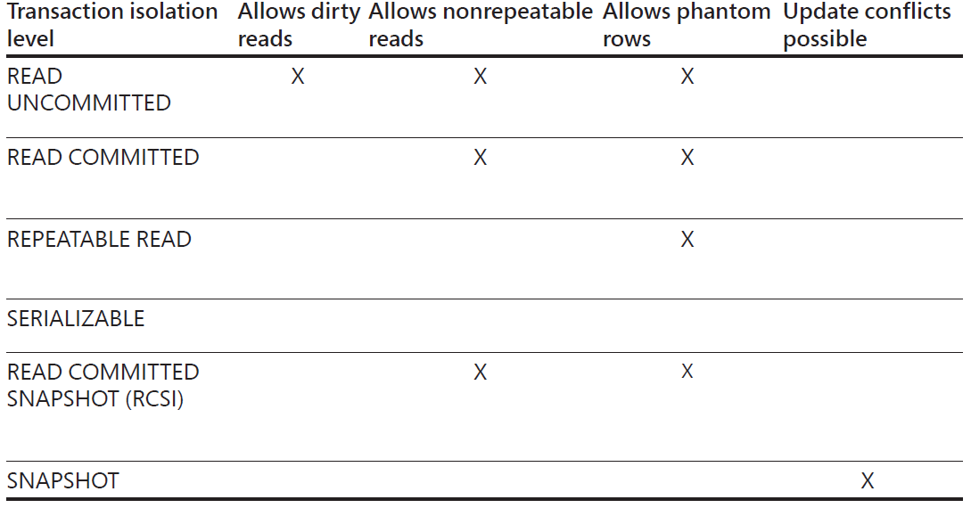
Isolation
or (NOLOCK)
*DEFAULT*

Slide 22
Writes are Always Isolated
Virtually all isolation levels behave the same for writes.
Writes are always serialized – you cannot insert/update/delete the same rows concurrently, regardless of isolation level.
SNAPSHOT (again, not RCSI) is the only isolation level where Update conflicts are possible, and should be used carefully.

Slide 23
Writes are Always Isolated
Update conflicts in SNAPSHOT will expose any transaction rollback/retry deficiencies your application has.
Your applications should always be aware of how transactions behave in a rollback and have retry logic if it makes sense, even if you never use SNAPSHOT.

Slide 24
Other Types of Isolation Issues
Nonrepeatable rows: if the same rows are read from more than once in a multi-step transaction, and are found to be different.
Solution: REPEATABLE READ isolation
Phantom records: if the same range of rows is read from more than once in a multi-step transaction, has a different rowcount.
Solution: SERIALIZABLE isolation

Slide 25
SERIALIZABLE
Some ORM’s default to SERIALIZABLE.
This is the most isolated, least concurrent
Therefore it is the safest, but can result in incredibly poor performance at scale if ALL read transactions are SERIALIZABLE.

Slide 26
How to tell what Isolation Level is in use?
Again, Toolbox: “sessions and requests.sql” to view live data.
Or sys.dm_Exec_requests to determine the isolation level of a query currently executing.

Slide 27
Indexing
Basics of a B-tree for searching data
A-Z
Branch levels
Leaf level
Search for “William”
Search for “Katherine”
A-M
N-Z
A-F
F-M
N-S
T-Z

Slide 28
Indexing
Two major types of indexes
There are more we’ll go over later
Clustered
One per table
Nonclustered
Many per table (but not too many!)

Slide 29
Clustered Index
The clustered index of your table defines how the table is logically organized in storage.
Clustered index design:
Benefits or maligns nonclustered indexes
Determines if/how badly the table with fragment its data pages upon insertion

Slide 30
Clustered Indexing Design
Good clustered index design is a performance issue.
A bad clustered index design will result in:
Fragmentation upon insertion
Table needs more space to store the same data
All nonclustered indexes contain the clustered key - so nonclustered indexes will be larger, too.

Slide 31
Good Clustered Indexing Design
Which columns in a table should be in the clustered index key?
Narrow - should be as small as possible
Unique – ideally is unique, for best performance
Non-changing – A system-generated surrogate key is best, a key value that users never see
Sequential – the table should ideally following the expected insertion order

Slide 32
Clustered Indexing Design
Good clustered index key:
ID integer IDENTITY(1,1) PRIMARY KEY
Integer – only 4 bytes per row, 2 billion unique values > 0
IDENTITY – auto-incrementing sequence
Primary Key – unique, used in referential integrity

Slide 33
Clustered Indexing Design
Bad clustered index key:
Uniqueidentifier – 16 bytes per row, random
Uniqueidentifier with newsequentialid() – 16 bytes per row, sequential until a restart, and then picks a new sequence start
Customer Name – potentially huge, not unique, can change
Date/time info – 6-8 bytes per row, not unique

Slide 34
Clustered Indexing Design
use w
go
CREATE TABLE dbo.ActivateTable
(id int IDENTITY (1,1) NOT NULL
,whatevernumber int NOT NULL
,whatevervarchar varchar(10) NOT NULL
,CONSTRAINT PK_ActivateTable PRIMARY KEY (id)
)
use w
go
CREATE TABLE dbo.ActivateTable
(id int IDENTITY (1,1) NOT NULL
,whatevernumber int NOT NULL
,whatevervarchar varchar(10) NOT NULL
,CONSTRAINT PK_ActivateTable PRIMARY KEY (id)
)

Slide 35
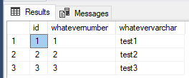
Clustered Indexing Design
USE w
GO
CREATE TABLE dbo.ActivateTable
(id int IDENTITY (1,1) NOT NULL
,whatevernumber int NOT NULL
,whatevervarchar varchar(10) NOT NULL
,CONSTRAINT PK_ActivateTable PRIMARY KEY (id)
)
GO
INSERT INTO dbo.ActivateTable (whatevernumber, whatevervarchar) VALUES (1, 'test1')
INSERT INTO dbo.ActivateTable (whatevernumber, whatevervarchar) VALUES (2, 'test2')
INSERT INTO dbo.ActivateTable (whatevernumber, whatevervarchar) VALUES (3, 'test3')
GO
SELECT * FROM dbo.ActivateTable

Slide 36
Clustered Indexing Design
Toolbox: lab - clustered key design.sql
Bad clustered index design brought the Windows 7 Release Candidate download page to its knees:
http://www.sqlskills.com/BLOGS/PAUL/post/Why-did-the-Windows-7-RC-failure-happen.aspx

Slide 37
Index Fragmentation
Different topic for another presentation, but you should be aware of your production database’s index maintenance
You should regularly perform:
ALTER INDEX… REBUILD
--Or--
ALTER INDEX… REORGANIZE
UPDATE STATISTICS…

Slide 38
The Clustered Index is the Table
The clustered index has a key, but contains all table data.
Without a clustered index, a table is called a Heap, and has no order. Without a B-Tree, Heaps can only be scanned in their entirety each time they are read.
Heap tables will not scale and will cause significant performance issues in your database.
Be on the lookout
Toolbox: “tables without clustered indexes.sql”

Slide 39
Nonclustered Indexes
A re-sorted copy of a vertical partition of the data
Can also be filtered with a WHERE clause
Has a key similar to a clustered index
Also has an INCLUDE column list (more on that later)
Rarely does a nonclustered index only include one column
Creating a nonclustered index on a Foreign Key column may help relational joins
Order of the keys matters!
an index on ColumnA, ColumnB is not the same as an index on ColumnB, ColumnA

Slide 40
Nonclustered Indexes
There is a cost-
Nonclustered indexes are typically designed to aid READS
But come with a penalty of marginally slowing WRITES
Too many nonclustered indexes? Writes will suffer, especially large-scale data loads, imports, migrations, etc.
Each nonclustered index must be kept transactionally relevant to the table data itself

Slide 41
Nonclusteed Indexes
Basics of a B-tree for searching data
A-Z
Key Columns Only
A-M
N-Z
Key and Include Columns
A-F
F-M
N-S
T-Z

Slide 42
Nonclustered Indexes
Key columns are for seeks
Usually in the WHERE, ON, HAVING syntax
Include columns
Usually in the SELECT, GROUP BY syntax only
Columns in the INCLUDE takes up significantly less space than if they were in the KEY of the nonclustered index

Slide 43
Nonclustered Indexes
Example:
SELECT ColumnA, ColumnB
FROM dbo.Table1
WHERE ColumnA = 'ABC’
Would be served by an index
key: ColumnA (needed in the branch levels)
INCLUDE: ColumnB (needed only in the leaf levels)

Slide 44
Missing Indexes Views
My favorite feature of introduced by SQL 2005!
The Missing Index DMV’s record whenever a queryplan recognized the need for an index that could have improved performance.
SQL records that recognized need, along with estimated statistics on cost and % improvement of the new index.

Slide 45
Missing Indexes Views
Passive. Doesn’t need to be turned on.
Cleared out when the server is rebooted, also cleared out for a table when you alter the table or indexes on that table.
One of the reasons why rebooting a SQL Server isn’t a helpful diagnostic step

Slide 46
Missing Indexes Views
Only recommends nonclustered indexes.
Won’t recommend a clustered index on a heap – that’s a design decision.
Won’t recommend xml, spatial index, fulltext index types.
Won’t recommend a compression setting.
Won’t recommend a columnstore index (in fact, will overlap/conflict)

Slide 47
Missing Indexes Views
Must be used with sobriety.
Don’t create every suggested missing index or your update/insert/deletes will suffer…
…most of the time. Writes can sometimes still benefit from nonclustered indexes by making more efficient queries from the source query (seeks instead of scans).

Slide 48
Missing Indexes Views
One index can be created to satisfy many suggestions.
Suggestions may only differ by column order, the columns in the key vs. INCLUDE’d, or by a small number of columns.
Combine suggestions together
Combine with existing indexes

Slide 49
Missing Indexes Views
An existing index may have all the columns needed, but some are in the INCLUDE, not the key of the index.
Or,
An existing index may need only one additional column in the key or INCLUDE. If so, replace the existing index.

Slide 50
Missing Indexes Views
When to use?
After you have actual usage running against your environment.
Don’t use during development, too likely to get misleading results and misaligned indexes.
Do use during user acceptance testing that simulates actual usage.
Do use on your production environment after a stable period of active and typical activity.

Slide 51
Missing Indexes Views
This is a very fast way to enter an environment, and take a peek at the indexing situation.
Are there lots of missing indexes screaming to be created?
Are there indexes only in older sections of the application?
Were indexes carefully created at the start of the application, but not recently?

Slide 52
Missing Indexes Views
Toolbox: Lab - missing index setup demo.sql
Toolbox: missing indexes.sql

Slide 53
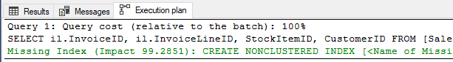
Final Note on Missing Indexes Views
Since SQL 2008 – Missing index views show at the top of the Show Query Plan in SSMS. Don’t!!
Again, Take a look at the whole picture, including all suggested indexes and all existing indexes, before creating any indexes.
Treat this as an alert that you may need to pay some attention to the missing indexes DMVs at aggregate.

Slide 54
Execution Plans
Multiple ways to view plans in SSMS
View the view plan as it executes (new in SQL 2014!)
View the actual plan after execution
View the estimated (but accurate) plan
View plans in cache (DMV’s, ex: Toolbox: “worst queries.sql”)
View plans by query (use the Query Store – more later)

Slide 55
Execution Plans
How to read execution plans:
Right to left
Top/bottom doesn’t matter
Export a plan as a .sqlplan file (XML) for reference later
Compare plans inside of SSMS
Free tool to assist with large plans: SentryOne Plan Explorer
https://www.sentryone.com/plan-explorer

Slide 56
Execution Plans
Look out for:
Scans
Unless it is a columnstore scan, those are awesome (more later)
Can probably be improved by adding an appropriate index
Lookups
Key lookups indicate that the query got some of the columns it needed from a nonclustered index, but had to make a second, expensive pass back for additional columns
Fix this by adding columns to key or INCLUDE of a nonclustered index
Table Scan
No clustered index! This is a heap, bad design!
Implicit Conversions
Data type mismatch – very bad for performance

Slide 57
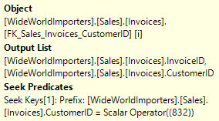
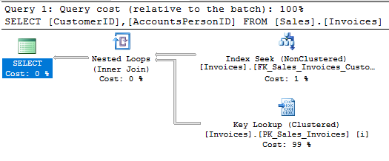
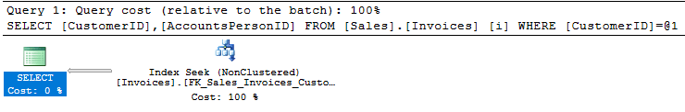
Fix Key Lookup Example
SELECT CustomerID, AccountsPersonID
FROM [Sales].[Invoices]
WHERE CustomerID = 832;
Properties of Index Seek (F4):
Where’s AccountsPersonID??
DROP INDEX IF EXISTS [FK_Sales_Invoices_CustomerID] ON [Sales].[Invoices];
GO
CREATE NONCLUSTERED INDEX [FK_Sales_Invoices_CustomerID] ON [Sales].[Invoices]
( [CustomerID] ASC )
INCLUDE ( [AccountsPersonID] )
ON [USERDATA];
GO

Slide 58
Moral of the Fix Key Lookup Example
The subtree cost in the properties of the SELECT operator (the left-most operator), is now 0.0034015, compared to 0.355919 when the Key Lookup was present, 118x less expensive.
Caveats:
VERY FEW queries are important enough to get their own nonclustered indexes created for them.
ALWAYS create nonclustered indexes that help MANY queries

Slide 59

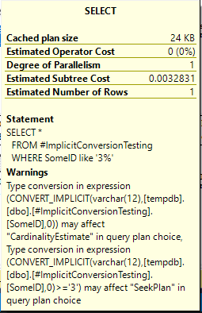
Implicit Conversions
Look for any yellow arrow, research and address
Commonly, this is an implicit conversion
Trying to compare numbers to strings, etc.
Or NVarchar to Varchar
Or dates to strings
At scale, or with large tables joins, bad!
Do not ignore!
Toolbox: Lab - implicit conversion.sql

Slide 60
Query Statistics
How can you tell which query is faster?
Comparing the costs of their execution plans is only a start
You can also precede your statements with these SESSION-level settings, which return a lot of data in text:
SET STATISTICS IO ON
SET STATISTICS TIME ON
--your code
SET STATISTICS TIME OFF
SET STATISTICS IO OFF

Slide 61
Columnstore Indexes Rock
Columnstore indexes aren’t new, have been around since SQL 2012.
Columnstore indexes are not a B-tree; instead, they contain highly compressed data (on disk and in memory).
Queries with millions of records are significantly faster.
Queries on small rowcount tables may not notice.

Slide 62
Columnstore Indexes Rock
You can create “nonclustered” or “clustered” Columnstore indexes, though these are in name only. Again, underlying structure is different, but Columnstore indexes can serve the roles of either.
Can only have one Columnstore index per table, and can mix rowstore nonclustered indexes with Columnstore indexes of any type.

Slide 63
Columnstore Indexes Rock
Writeable as of SQL 2016. Prior, a CS index was read-only.
This finally unleashes columnstore indexes.
With SQL Server 2016 SP1, Columnstore indexes are available below Enterprise edition with memory limits.

Slide 64
Columnstore Indexes Rock
Starting with SQL 2017, Columnstore indexes are the only objects for which SQL can use Batch Mode execution.
Available in Compatibility Level 14.0 (SQL 2017) only.
You’ll see “Batch” (instead of the default “Row”) in the Actual Execution Mode of an execution plan operator
Batch mode memory grants and adaptive joins are part of new Adaptive Query Processing in SQL 2017. https://docs.microsoft.com/en-us/sql/relational-databases/performance/adaptive-query-processing

Slide 65
Memory-Optimized Tables
Aka In-Memory tables
Use when extremely-rapid inserts are needed
Starting with SQL 2016, you can add a Columnstore index to in-memory tables for “real-time analytics”.
Tables are actually in memory, if you run out of available memory in the SQL Server, the table will become unavailable!

Slide 66
Memory-Optimized Tables
Despite being in memory, the table is still fully durable. If the server unexpectedly shuts down – still good.
DURABILITY = SCHEMA_AND_DATA
You can declare memory-optimized table with SCHEMA_ONLY durability, meaning that it really is in-memory ONLY, and will empty out when the SQL Server instance restarts.

Slide 67
Memory-Optimized Tables
Toolbox: Lab - testing mem opt.sql
Writes and reads can be faster vs disk-based table
Insert 4194304 rows into a table in a single command
CPU time total time (ms)
disk-based table 17937 23705
mem-opt table 6579 8780
mem-opt with columnstore 6172 9009
mem-opt schema_only 5953 5956

Slide 68
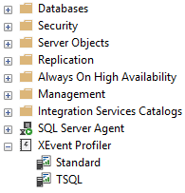
New Feature in SSMS (17.3+)
New easy-to-use Extended Events sessions at bottom of Object Explorer
Works all the way down to SQL 2008 R2
Pre-made XEvent sessions geared to appear familiar to the TSQL traces provided by Profiler
Ditch Profiler and Trace: XEvents are better!
Superior filtering, sorting, all inside SSMS
Superior performance – asynchronous means little overhead
Capture to a variety of outputs including an in-memory Ring Buffer or a Histogram to count incidents of events

Slide 69
Query Store
New in SQL 2016, even better in SQL 2017.
Starting with SQL 2017, Query Store tracks Wait Stats too
A feature that was developed for Azure SQL first!
Tracks the performance of queries – not of execution plans – a distinct difference. Can detect when a query has suffered a degradation in performance because its query plan has changed.

Slide 70
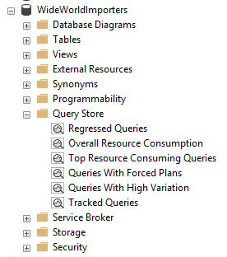
Query Store
Built-in reports make analysis easy
For SQL Server instances, this isn’t enabled by default. Go enable it.
Minimal overhead – collected data is stored asynchronously, flushed to disk periodically

Slide 71
Query Store
The “worst plans in cache” is a common strategy to identify the most expensive plans
The Query Store is one step better – finding the recent “worst queries” regardless of plan, with sortable/aggregable metrics to launch your performance tuning as a developer or DBA.

Slide 72
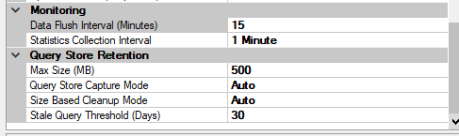
Query Store
Data Flush Interval
In-memory Data that could be lost in the event of a system crash or sudden power loss. Default 15 minutes
Statistics Collection Interval
Grain of the data collection. Default of 1 hour.
Defines the automatically generated time windows and stores aggregated statistics on that interval
Max Size (MB)
Actual space on disk inside the user database. Default 100 MB probably isn’t enough to track busy history.

Slide 73
Query Store
By default Query Store automatically cleans up, removing the least expensive and oldest queries first as the data approaches the Max Size (MB).
You can also manually clear the Query Store data (for testing only) with the command:
ALTER DATABASE [WideWorldImporters] SET QUERY_STORE CLEAR

Slide 74
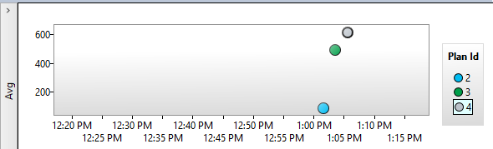
Query Store
Regressed Queries highlights query execution over time
Bad!
A lot of reasons queries could regress, dropping indexes (results in a new plan) is easy reproduced
Plans could be flushed from cache, recreated differently
Other reasons: parameter sniffing, changing or outdated statistics, changing compatibility levels +-12.0 (2014).

Slide 75
Query Store – Next Logical Step?
What if SQL Server could use information about Regressed Queries and a history of execution plans to decisions to automatically use a better plan?
Now it can!
Automatic Plan Correction (new to SQL 2017)!
Again, Azure SQL Database already does this for you!

Slide 76
Automatic Plan Correction
“Automatic Plan Tuning” is based on Query Store
Available in Azure SQL and now in SQL 2017 to revert a query from a newer, slower plan to an older, faster plan.

Slide 77
Automatic Plan Correction
You can also accomplish this manually yourself, or query the underlying information yourself, with a host of DMV’s including sys.dm_db_tuning_recommendations
Sample query: https://docs.microsoft.com/en-us/sql/relational-databases/automatic-tuning/automatic-tuning

Slide 78
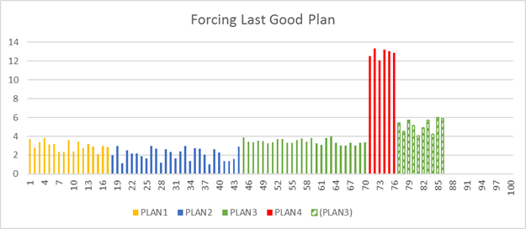
Automatic Plan Correction
https://docs.microsoft.com/en-us/sql/relational-databases/automatic-tuning/automatic-tuning#automatic-plan-correction

Slide 79
Automatic Plan Correction
Not on by default, you must enable
Once you turn-on this option, Database Engine will automatically force any recommendation where the estimated CPU gain is higher than 10 seconds.
ALTER DATABASE WideWorldImporters
SET AUTOMATIC_TUNING ( FORCE_LAST_GOOD_PLAN = ON );

Slide 80

SQL Server Product Changes Recently
Other velocity-increasing changes:
- No more service packs, CU’s only.
Within 2 months of release, SQL 2017
already had 3 CU’s.
Stated goal of one CU per month at least for one year
- SSMS pulled out of .iso in SQL 2016, web download now
New releases every two months throughout 2017
- SSRS pulled out of .iso in SQL 2017, web download now

Slide 81
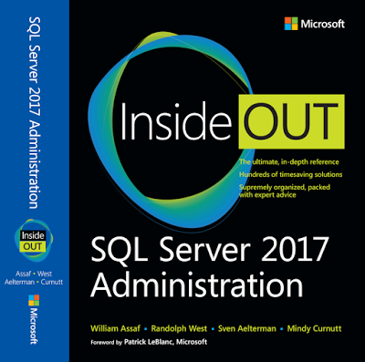
Favorite New Features of SQL 2017
http://www.sqltact.com/2017/12/our-sql-server-2017-administration.html
4. What's your favorite new feature of SQL Server 2017?
William Assaf: WSFC-less Availability Groups. So many uses, so much easier. Combined with automatic seeding, AG's are getting pretty close to point-and-click.
Randolph West: Linux support. Adaptive query processing.
Sven Aelterman: Without a doubt, the fact that Reporting Services is a separate download. Everyone loves an additional installer.
Mindy Curnutt: Resumable online index rebuilds!! How many times could I have used this.
Louis Davidson: I am into database coding/designing mostly, so graph tables are highest for sure. They are pretty rudimentary now, but the future is very bright in what they are adding in a future version.

Slide 82
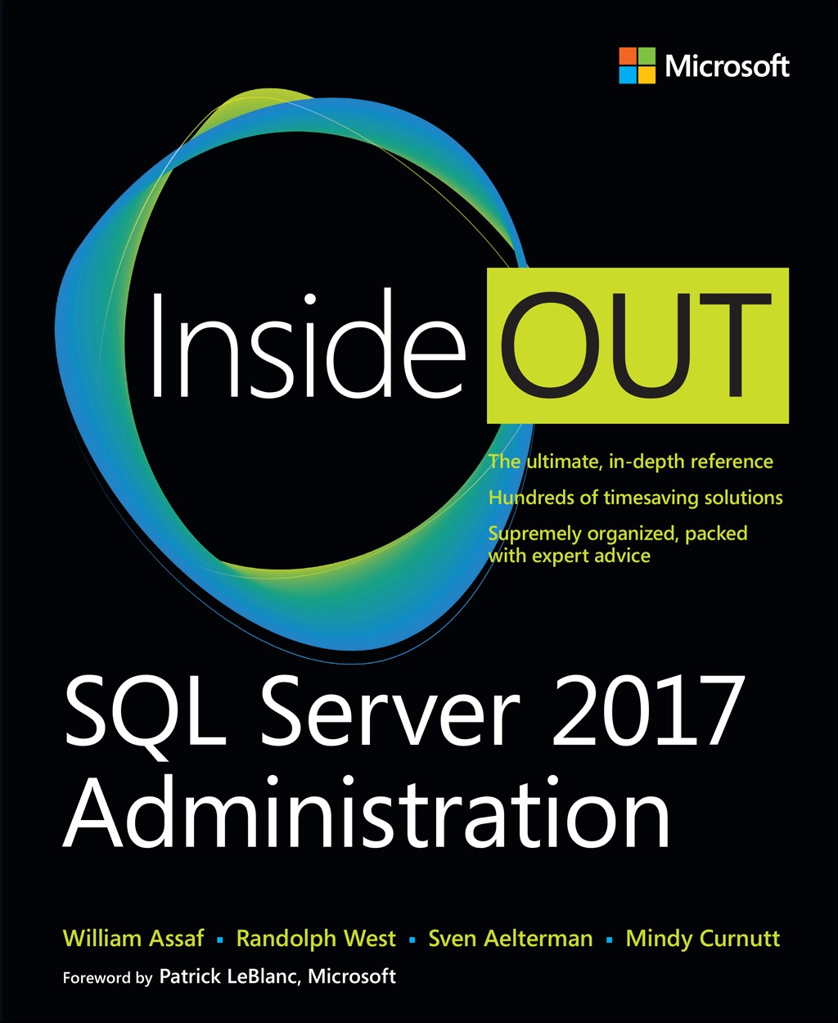
Save 40% on book or eBook
with discount code SQL
www.microsoftpressstore.com
Free U.S. shipping
eBooks include EPUB, PDF, & MOBI
Offer expires May 31, 2018

Slide 83





Free SQL Server, .NET, Business Intelligence training and more!
An all day FREE training event with SQL Server and Development related sessions spread out over multiple tracks of Business Intelligence, SQL Development,
Database Administration, IT Pro, .NET,
Career Development, and CIO/IT Management
See you August 11 at
SQLSatBR.com

Slide 84
Bio and contact
William D Assaf, MCSE
Baton Rouge SQL Server UG board and SQLSaturday chair
Principal Consultant, Manager – DBA Team at
Sparkhound Inc. in Baton Rouge
William.Assaf@sparkhound.com
Twitter: @william_a_dba
This presentation, including all source code and this slide deck, has been posted at my blog:
SQLTact.com

